Slide 1
Advanced CNN Concepts and Inception Networks
Dr. Meghna Kapoor

Slide 2
Learning Objectives
Advanced convolution operations
Receptive Fields in CNN
Residual connections
Inception family

Slide 3
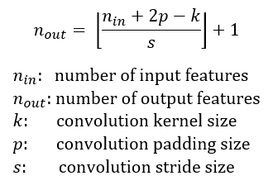
Why Extend Basic CNNs
Basic Conv → ReLU → Pool is limited because:
Large kernels increase parameters and FLOPs
A single kernel size cannot capture features at multiple scales
Deeper networks face issues like vanishing gradient

Slide 4
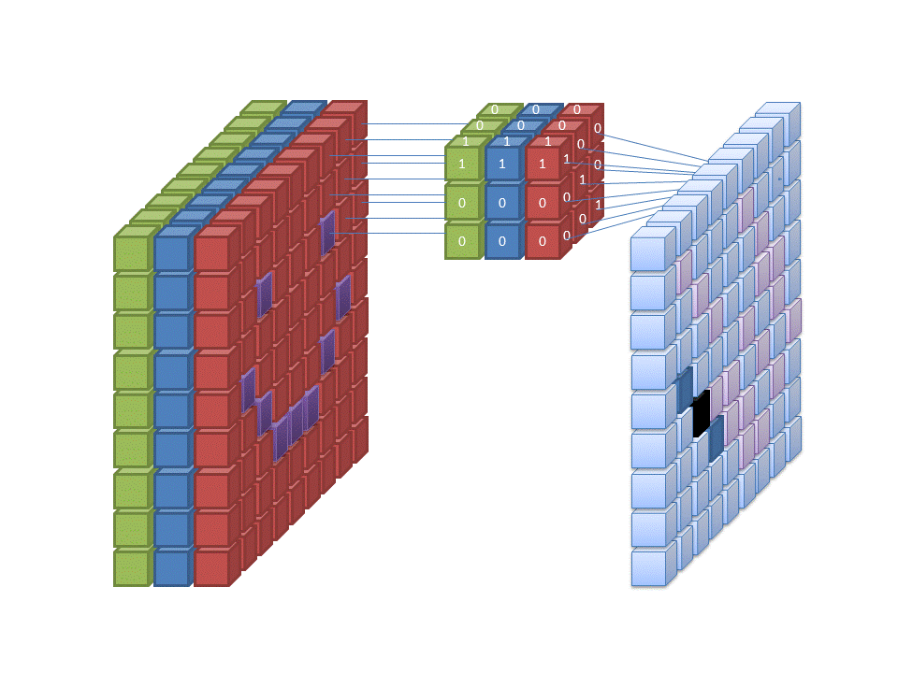
Standard Convolution

Slide 5
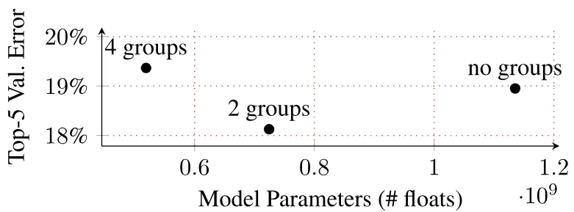
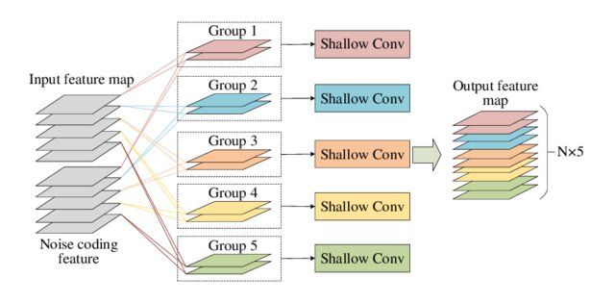
Group Convolution
Splits input channels into independent groups
Each group is convolved separately
Reduces parameters and computation

Slide 6
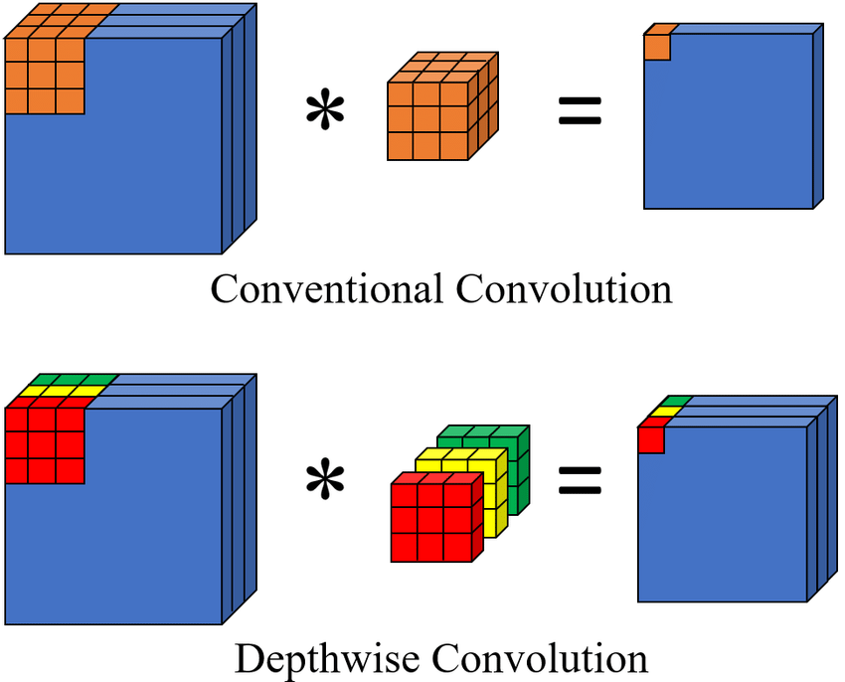
Depth wise Convolution
Applies one filter per input channel
No mixing across channels
Performs spatial filtering only
Drastically reduces parameters

Slide 7
Intuition
Standard convolution: everyone talks to everyone.
Group convolution: small teams talk internally.
Depthwise convolution: everyone works alone.

Slide 8
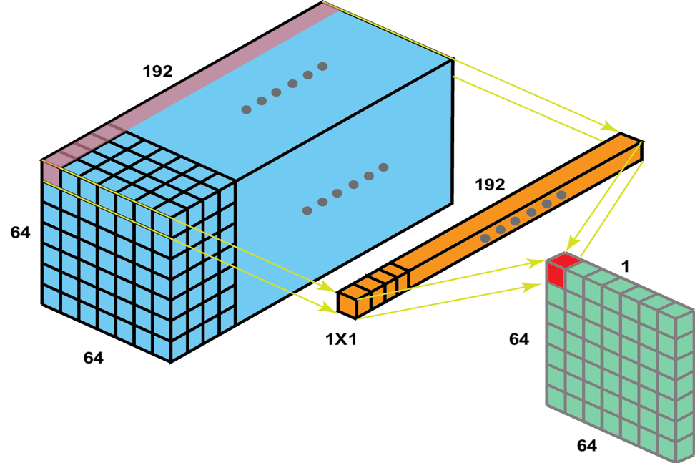
1x1 convolution
Mixes information across channels
Controls channel dimensionality

Slide 9
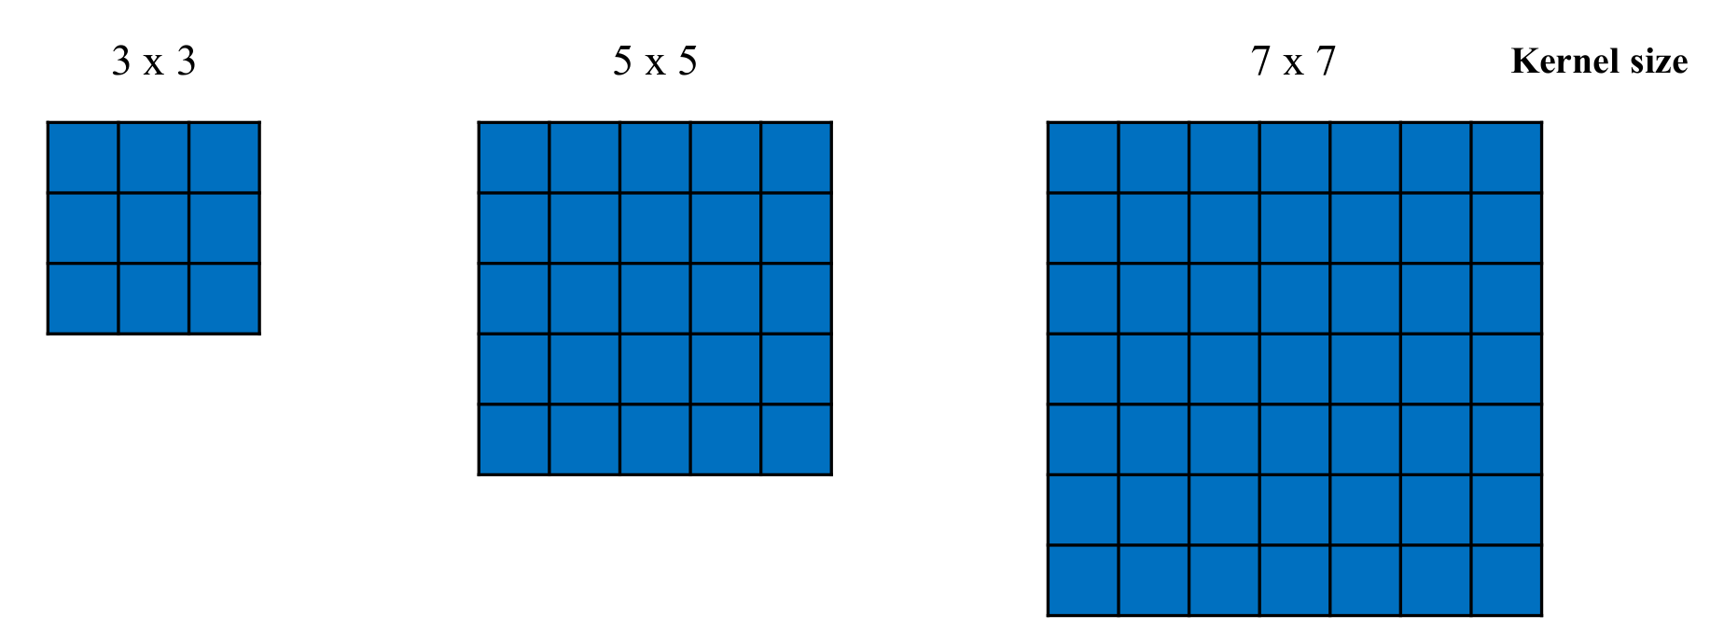
Receptive Field
Region of input influencing one activation
Controlled by kernel size and stride
Larger kernels increase receptive field
Stacking layers also increases receptive field

Slide 10
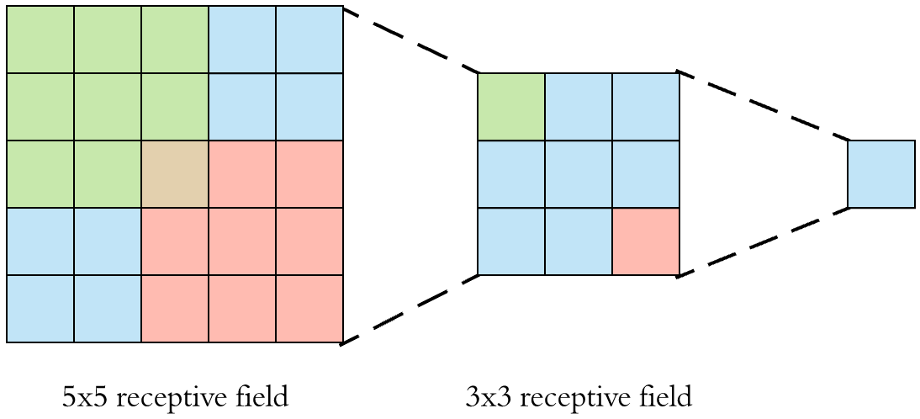
Receptive Field
One 3×3 convolution → receptive field = 3
Two stacked 3×3 convolutions → receptive field = 5
For kernel size k and layers L, receptive field can be discussed as;
RF = 1 + (k − 1) × L

Slide 11
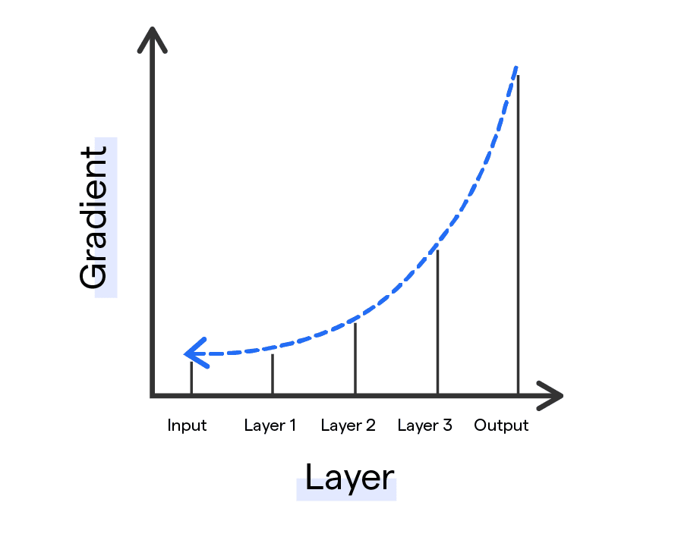
Residual Connection Motivation
Deeper networks are harder to train
Accuracy degrades with depth
Vanishing gradients slow learning
Optimization becomes unstable

Slide 12
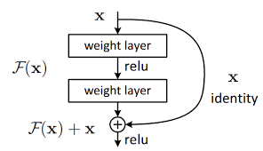
Residual Connections
Learn residual mapping instead of direct mapping
Output = F(x) + x
Identity shortcut preserves information

Slide 13
Inception Block
Single kernel size is insufficient
Objects appear at multiple scales
Large kernels are computationally expensive
Need efficient multi scale feature extraction

Slide 14
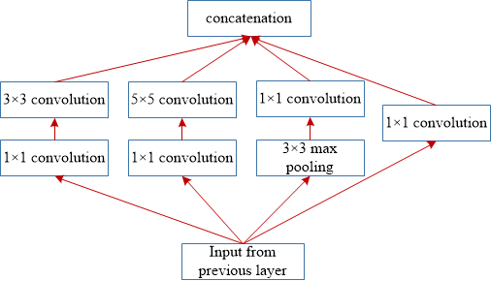
Inception Block
Parallel convolution branches
Different kernel sizes per branch
Capture local and global patterns together
Concatenate features along channel dimension

